Slide 1

Washington States – US Companies
Washington GDP : $425B (1/6 of FR GDP), 7M people (+20% / 10 years)
Large businesses HQ in WA:
Computer: Microsoft, Bungie, Amazon.com, Nintendo of America, Valve Corporation, ArenaNet
Telecom (T-Mobile USA), electronics, biotechnology, aluminum production, lumber and wood products (Weyerhaeuser), mining
Beverages (Starbucks, Jones Soda), real estate (John L. Scott),
Retail (Nordstrom, Eddie Bauer, Fred Meyer, Car Toys, Costco, R.E.I., Zulily.com, Expeditors),
Tourism (Alaska Airlines, Expedia), healthcare (providence…)
Automotive (Paccar), Aircraft / Aerospace (Boeing, Esterline)
Major Hydroelectric power generation (Itron, Puget sound energy)
wine (#2 USA), 75 ports, 139 airports (major US / Asia hub)

Slide 2
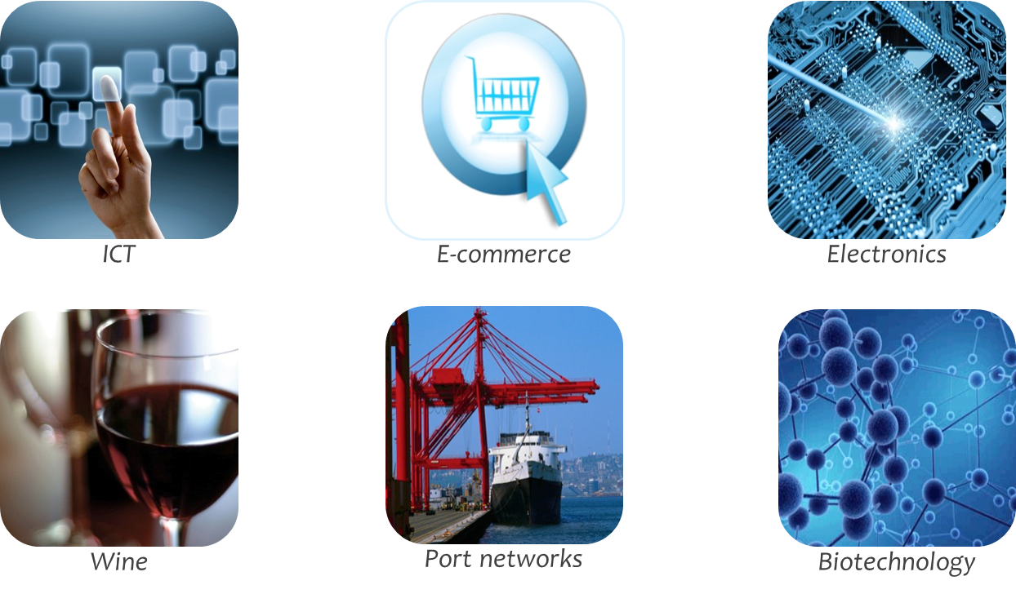

Washington State – Growth sectors

Slide 3
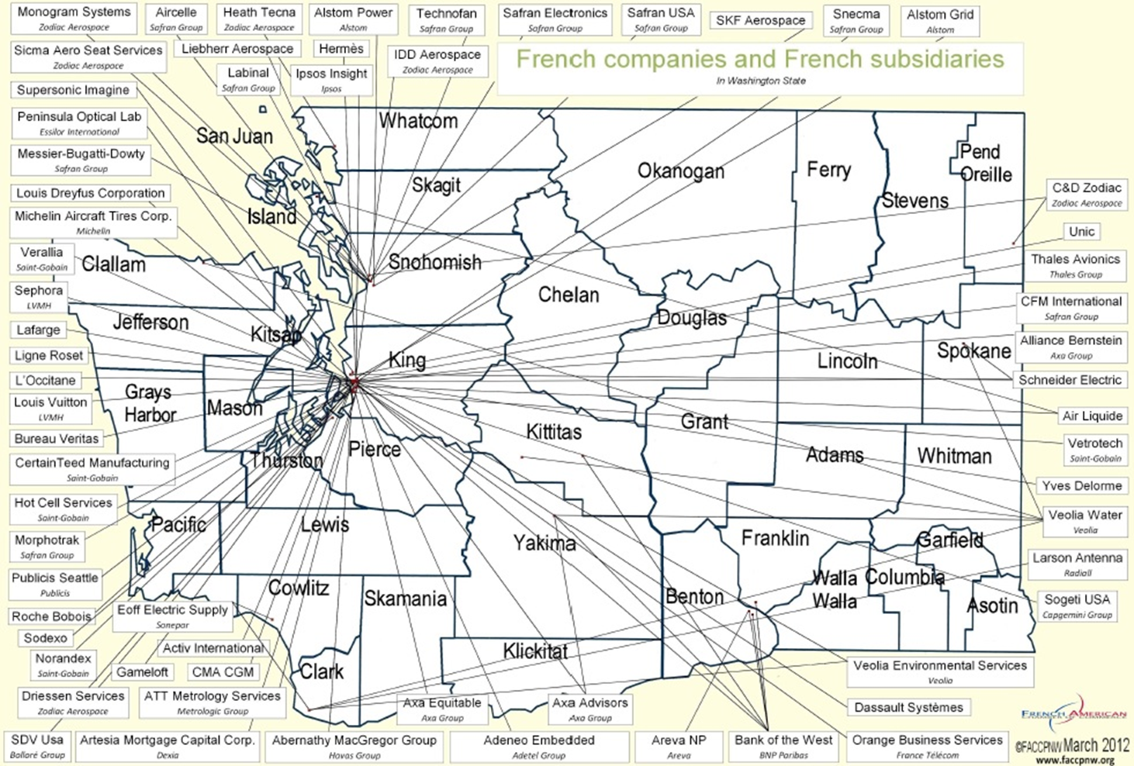
Washington State - French companies presence

Slide 4
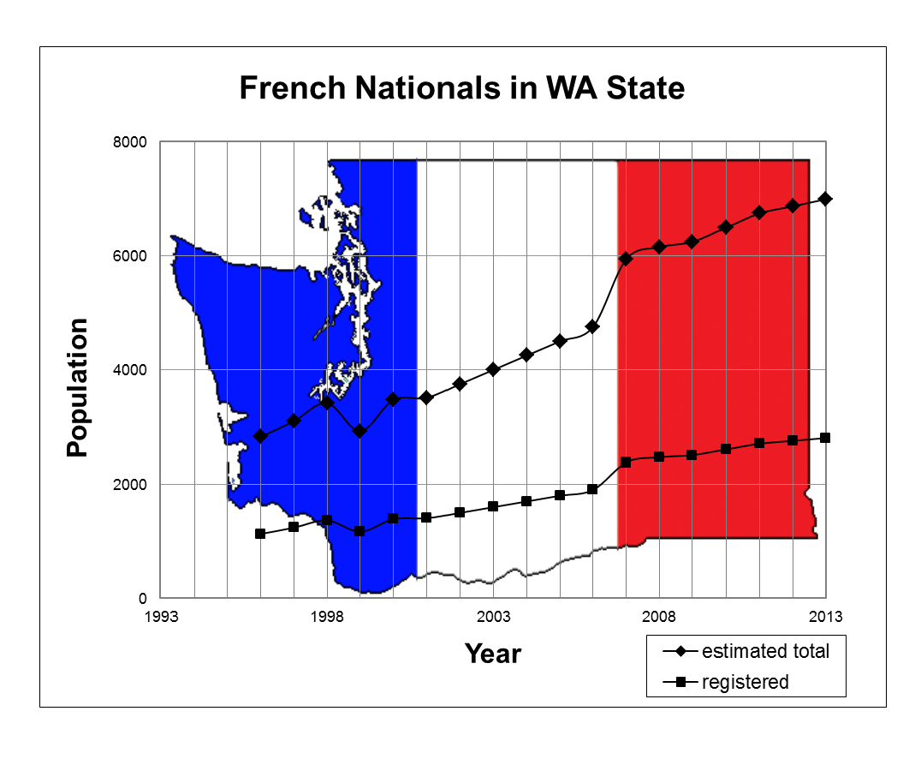
Washington State - French Nationals
Washington : 2400 registered (7000 estimation)
Oregon : 1100, Idaho : 184 (=> 3000 estimation)
= Over 10,000 French people in PNW

Slide 5
FACC High-Tech & Innovation Committee
Board Members
Philippe | Battel | Microsoft | pbattel@microsoft.com
Christophe | Herrbach | Microsoft | christophe.herrbach@microsoft.com
Anne-Chloé | Wambre | amazon.com | acwambre@amazon.com
Marion | Desmazieres | amazon.com | marion.desmaz@gmail.com
Geoffroy | Pajot | Sogeti Group | geoffroy.pajot@us.sogeti.com
Gregorie | Clayes | Independent consultant | gclayes@gmail.com
Bruno | Gralpois | Agency Mania Solutions | bruno@agencymaniasolutions.com
Alexandre | Zhangellini | Arzeda | alexandre.zanghellini@arzeda.com
Committee Members – 114 people in 60 companies, from CEO to developer, from Sales. to Engineering
amazon.com
Dassault Systemes
Adeneo Embeded
Alstom Grid Inc.
Exequo
Sogeti Group
WA Department of Commerce
Independent consultant
Realnetworks
Consulate General of France
Microsoft
Agency Mania Solutions
Arzeda
Nordstrom
Aerospace Precision, Inc.
ArenaNet
Maestrano
Auth0
Azaleos Corporation
Capital One Sharebuilder
Marvell Semiconductor
CTL2 (Founder Sagem Morpho)
Eagleview
Ecova
Endeavor Consulting
Gameloft
Glympse
GoDaddy
Google
HyperQuality Inc.
InstantService Inc.
Intel Corporation
Intermec
iSEC Partners
iShow.com, Inc
IT Consultant
LendingRobot.com
Lucid8
meridian school
MetaInfo
Mintonic
Monolith productions
Neos-Sdi
OneAccord Corp
Open Systems Management
Phd Artificial inteligence
Sagem avionics
SquareHub
Starbucks
Streambox Inc.
Tableau Software
The Pokémon Comp. Intern.
T-Mobile
University of Washington
Valve
Xoasis Networks Inc.

Slide 6
FACC High-Tech & Innovation Committee
Scope: High-Tech & Innovation (not just IT, not aerospace, business-related topics only)
Members: focus on French-speaking people (“francophones”) in PNW states
Goals:
Share ideas & learnings between members
Networking, career/job support, buzz dev.
Business insights on other industries
Learn about innovations, startups and trends
Activities:
4 meetings per year : 1 at Amazon, 1 at Microsoft, 2 in other locations (e.g. EXEQUO – thx you !)
Linkedin platform for sharing and communication
Ad-hoc meetings in partnership with other initiatives e.g. start-up week-ends, wile42.org etc.
Ambition
300+ members 6/2016, 60+ at quarterly events, 1000+ members 6/2017, 100+ at quarterly events
Highlight & drive innovation from French in PNW, support success of FR-speaking in PNW / FR
Support FACC goals including French-American business collaboration

Slide 7
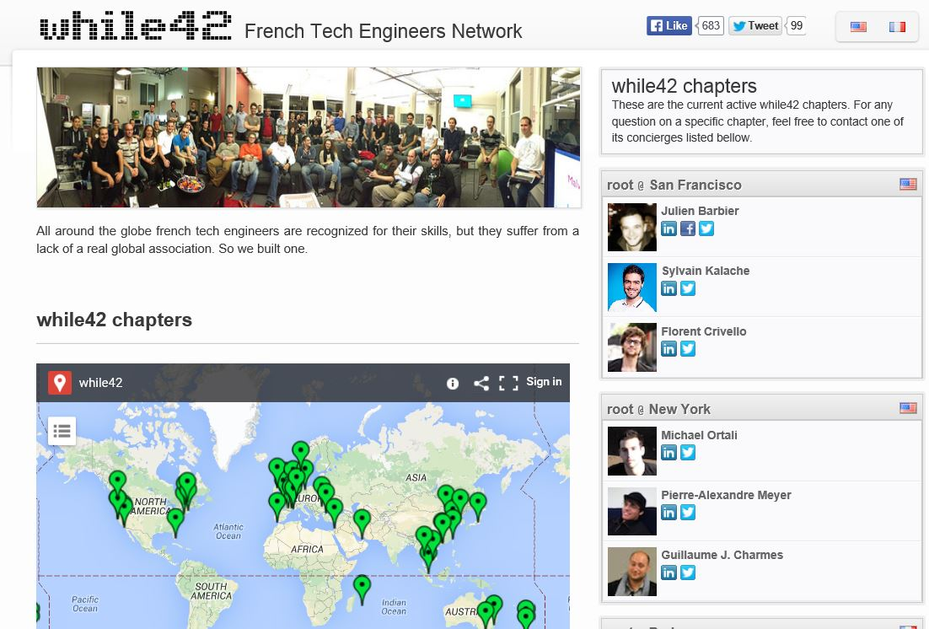
While42.org

